Slide 1
Mass Storage Structure
Magnetic Disks
Traditional magnetic disks have the following basic structure:
One or more platters in the form of disks covered with magnetic media. Hard disk platters are made of rigid metal, while "floppy" disks are made of more flexible plastic.
Each platter has two working surfaces. Older hard disk drives would sometimes not use the very top or bottom surface of a stack of platters, as these surfaces were more susceptible to potential damage.
Each working surface is divided into a number of concentric rings called tracks. The collection of all tracks that are the same distance from the edge of the platter, ( i.e. all tracks immediately above one another in the following diagram ) is called a cylinder.

Slide 2
Each track is further divided into sectors, traditionally containing 512 bytes of data each, although some modern disks occasionally use larger sector sizes. ( Sectors also include a header and a trailer, including checksum information among other things.
Larger sector sizes reduce the fraction of the disk consumed by headers and trailers, but increase internal fragmentation and the amount of disk that must be marked bad in the case of errors. )
The data on a hard drive is read by read-write heads. The standard configuration ( shown below ) uses one head per surface, each on a separate arm, and controlled by a common arm assembly which moves all heads simultaneously from one cylinder to another.
( Other configurations, including independent read-write heads, may speed up disk access, but involve serious technical difficulties. )

Slide 3
The storage capacity of a traditional disk drive is equal to the number of heads ( i.e. the number of working surfaces ), times the number of tracks per surface, times the number of sectors per track, times the number of bytes per sector.
A particular physical block of data is specified by providing the head-sector-cylinder number at which it is located.

Slide 4
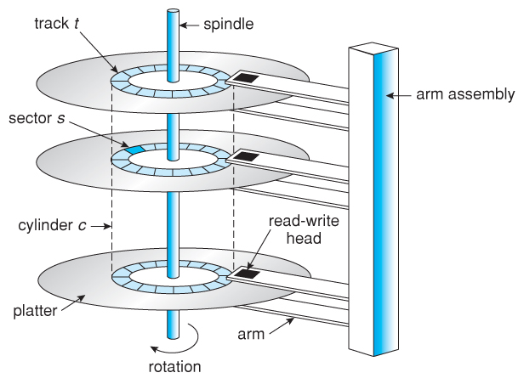

Slide 5
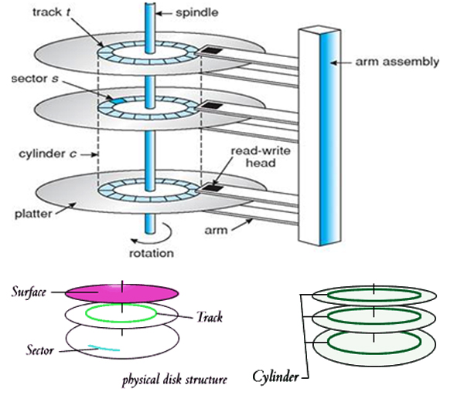

Slide 6
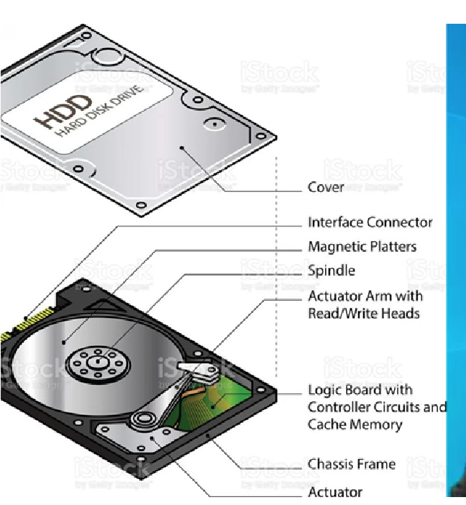

Slide 7
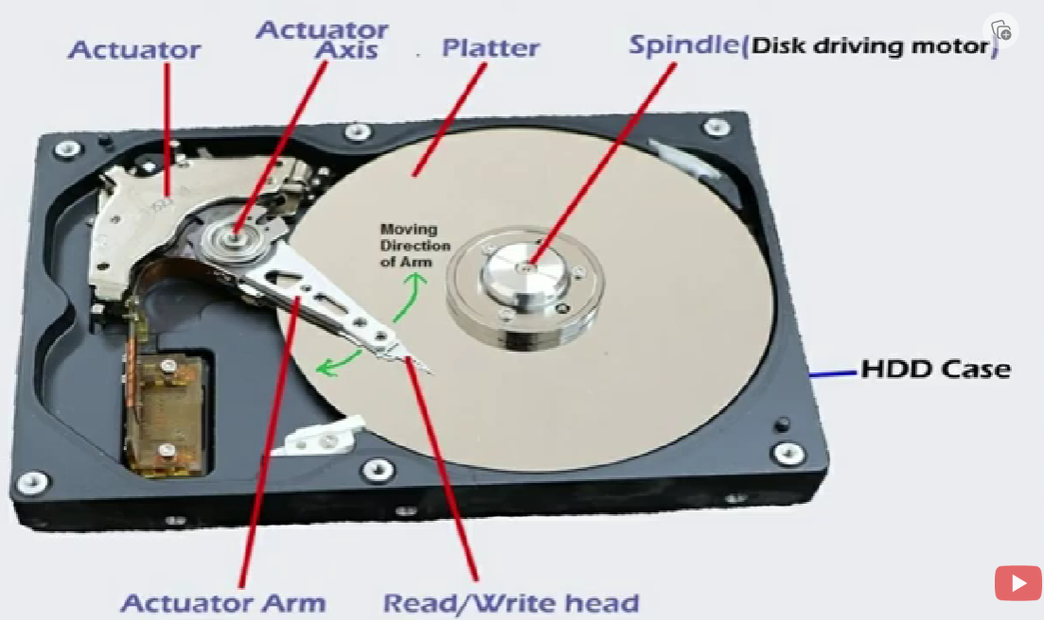

Slide 8
Solid State Disk
SSD is a non-volatile storage device, which stands for Solid State Drive.
SSD stores the data on flash memory chips and maintains the data in a permanent state, even when the power is off.
Unlike traditional hard disk drives (HDDs) that rely on rotating disks and mechanical components for data storage and retrieval.
Sometimes, this storage device is also called as a solid-state disk or solid-state device. Unlike the HDDs (Hard Disk Drives), SSDs do not have any moving parts. That's why they are called solid-state drives.
As compared to electromechanical drives, SSDs have lower latency and access quickly. As a result, SSDs offer advantages such as reduced boot times, quicker file transfers, and advanced system overall performance.

Slide 9
Activities that used to require numerous minutes on an HDD, which include launching resource-in-depth applications or searching for files, can now be carried out within seconds with the speed and efficiency of an SSD.
These storage devices store the data in the semiconductor cells. It uses electric charges to represent binary information.
This technology enables more compact and lightweight storage solutions, making SSDs suitable for various applications such as laptops, desktop computers, game consoles, and data centers.
The impact SSDs have had on modern computers is significant.
It has transformed the user experience by reducing system bottlenecks and eliminating long delays traditionally associated with hard drives.
Faster data access means tasks can be completed more efficiently, increasing productivity and user satisfaction.

Slide 10
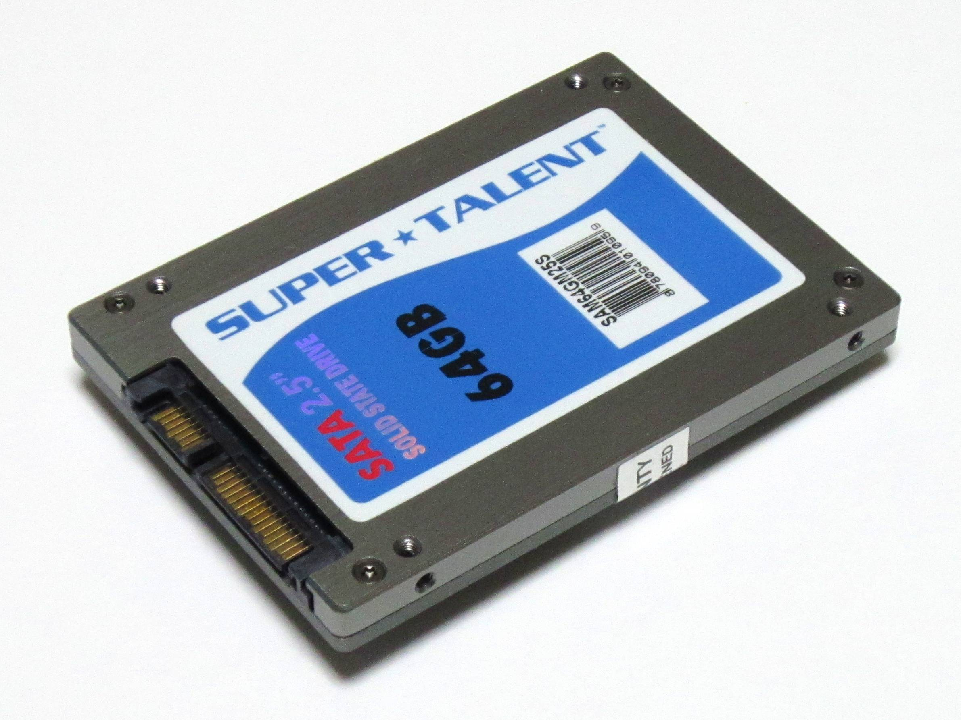
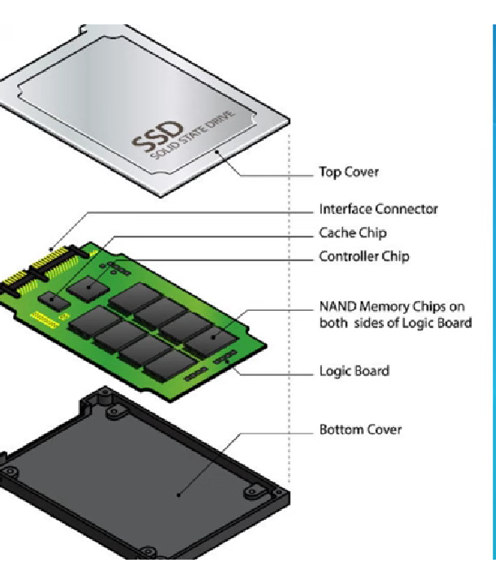

Slide 11
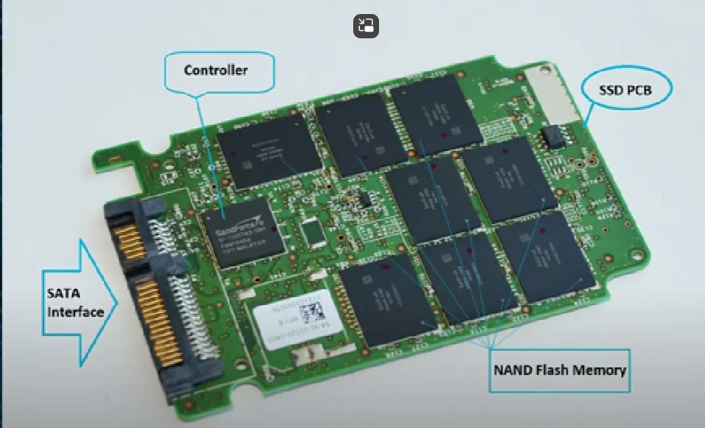

Slide 12
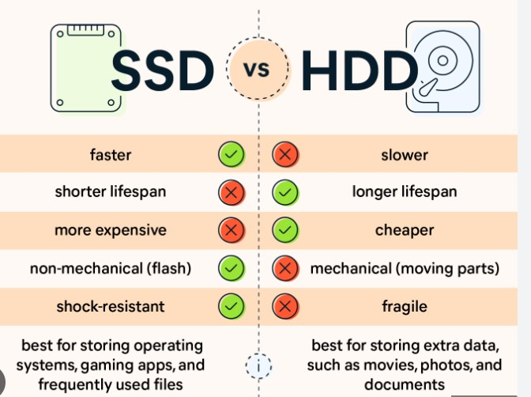

Slide 13
Magnetic Tapes
Prior to the advent of hard disk drives, magnetic tapes were frequently utilized for secondary storage; today, they are mostly used for backups.
It might take a while to get to a specific location on a magnetic tape, but once reading or writing starts, access rates are on par with disk drives.
Tape drive capacities may be anywhere from 20 and 200 GB, and compression can increase that capacity by double.

Slide 14
Disk Attachment
There are two ways for computers to access disc storage.
One method is to use I/O ports, also known as host-attached storage, on small systems. Another method is through a remote host in a distributed file system, which is known as network-attached storage.

Slide 15
Host-Attached Storage
Host-attached storage (HAS) is a form of internal computer storage that can be attached to a host computer, such as a PC or server.
Host-attached devices are often used for backup purposes and can include tape drives, optical drives, hard disk drives (HDDs), solid state drives (SSDs), USB flash drives, and other similar media.
A common example of host-attached storage is the use of an external USB flash drive for data transfer between computers.
This type of connection allows users to copy files from one device onto another without having to connect them directly through their operating system’s file-sharing functionality – this means that you don’t have access rights over your own system if someone else has access!

Slide 16
Host-attached storage is usually very fast, which makes it a popular choice for high-performance applications.
It’s also relatively cheap compared to network-attached storage (NAS), which is another form of internal computer storage that can be accessed by multiple systems at once.
Host-attached storage systems are often used in data centers because of their high performance and reliability.
These devices are usually more expensive than NAS devices, but they offer many benefits over other types of internal computer storage.

